Slide 1
Physical Education
9-12/Health
May 22, 2020

Slide 2
9-12 Health
Lesson: May 22,2020
Objective/Learning Target: Achieving Mental and Emotional Health
Chapter 15.4 Improving Your Mental and Emotional Health
1. Identify characteristics of people with good mental and emotional health.
2. Describe strategies for improving mental and emotional health.
3. Give examples of strategies for improving physical health.
4. Recognize strategies for improving intellectual health.
5. Explain when professional help is needed to improve mental and emotional health.

Slide 3
Bell Work
Why is developing new skills and interests important for good mental and emotional health?
What are some activities you can do to explore new talents or interests?

Slide 4
Good Mental and Emotional Health
People with good mental and emotional health share certain traits
–Having a zest for life
–Being responsible
–Keeping a sense of balance
–Being trustworthy, respectful, kind, and compassionate
–Demonstrating good citizenship

Slide 5
Improving Mental Health
Strategies you can use to help improve your mental and emotional health
–Spend time in nature
–Develop strategies for reducing stress
–Set and work toward goals
–Have fun
–Focus on the good, not
the bad
–Maintain close relationships

Slide 6
Improving Physical Health
•Improving your physical health will lead to better mental and emotional well-being
•Follow these strategies
–Get adequate sleep
–Practice good nutrition
–Get plenty of physical activity
–Avoid risky behaviors

Slide 7
Improving Intellectual Health
•There are many ways you can work on improving your intellectual health
–Make good decisions
–Develop new skills and interests
–Play games
–Read a book for pleasure

Slide 8
Critical Thinking
Relationships
Why do you think maintaining close relationships with other people is important for good mental and emotional health?

Slide 9
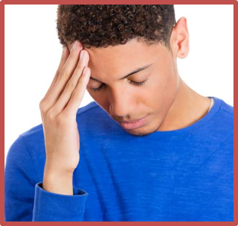
Getting Help When You Need It
•Some people may make a real effort to improve their mental and emotional health and still do not feel better
•These people should consider getting help from a counselor or other mental health professional

Slide 10
Activity
15.4 Flash Cards
15.4 Matching

